Slide 1
Get hired
Unlock Your Career Potential - Where Dreams Meet Opportunities!
GET YOUR FIRST JOB WITH A SALARY HIKE IN JUST 7 DAYS!

Slide 2

Project Work
Frontend : Akshit Goel
Backend : Akshit Goel
Submitted to: Mr Vaibhav Mittal

Slide 3

Contents
Problem Statement
Introduction
Key features and Functionality
Demonstration
Tech-stack used
Application UI
Project Impact and Future Developments

Slide 4

Problem Statement
Navigating the current job market is a challenge for both job seekers and recruiters. Existing portals lack accessibility, resulting in a fragmented and inefficient experience. Recruiters grapple with decentralized platforms, leading to time-consuming processes. Security concerns further impede user trust. Our project aims to revolutionize this landscape by addressing these issues. We strive to create a user-friendly, secure, and efficient job portal, bridging the gap between opportunity and talent. Join us in reshaping the future of employment connections.

Slide 5
Introduction and Our Approach
1. Simplified Job Hunt with MERN Stack
2. Effortless Recruitment Process
3. User-Friendly Interface
4. Connecting Talent
5. Innovative MERN Stack Technologies
6. Enhanced Security Measures

Slide 6
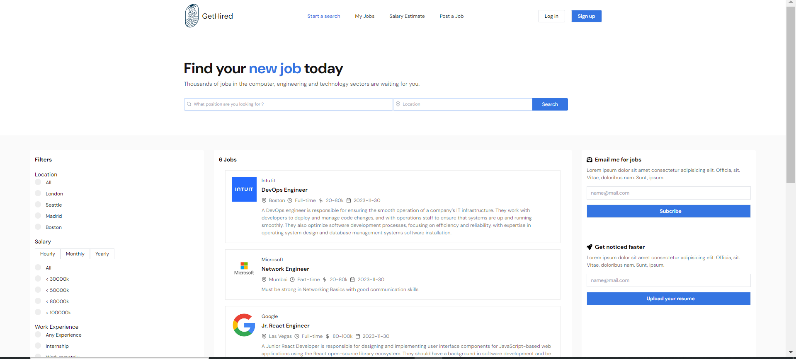
User Interface
Home Page

Slide 7
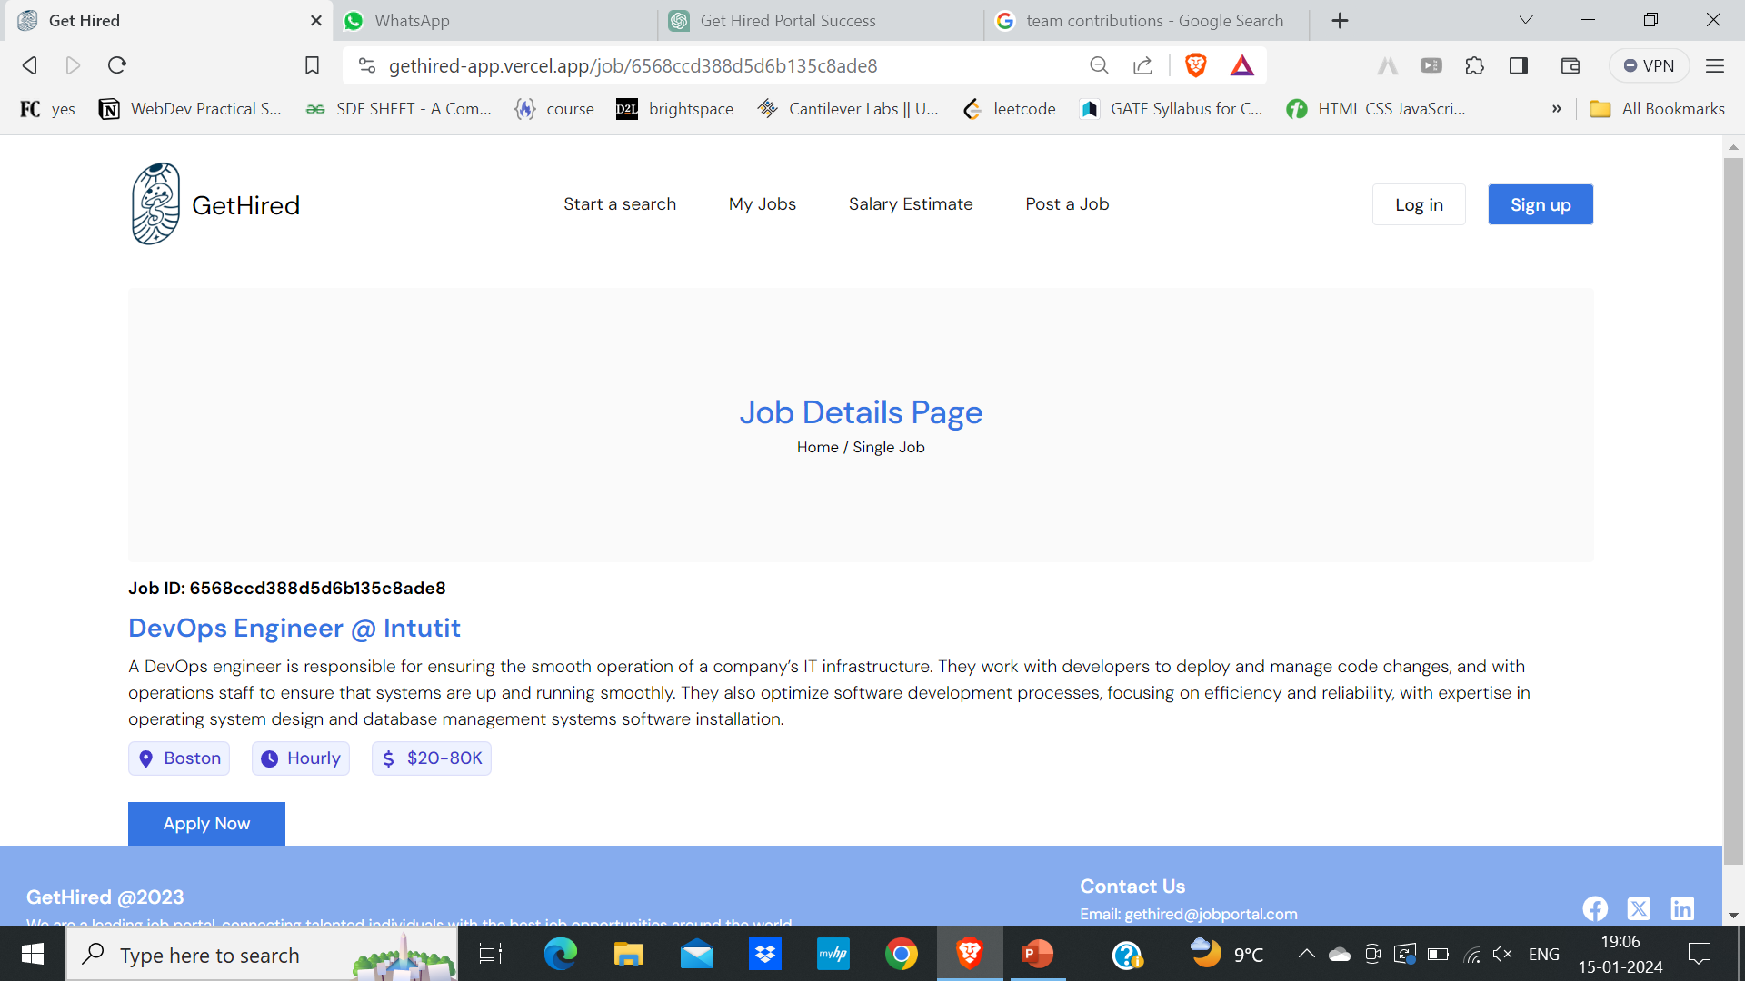
User Interface
Job Details Page

Slide 8
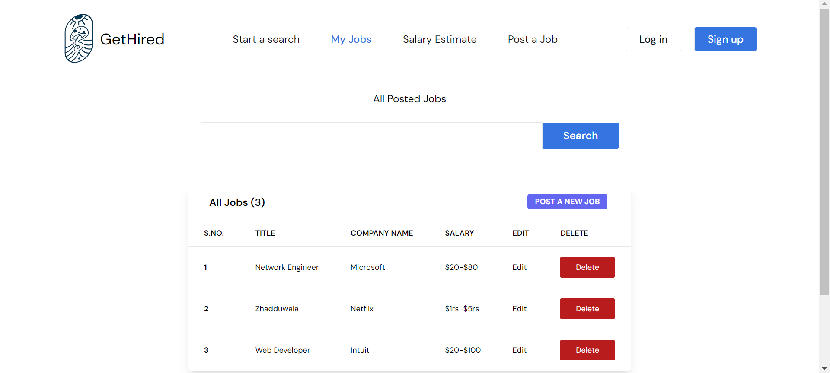
User Interface
My Jobs page

Slide 9
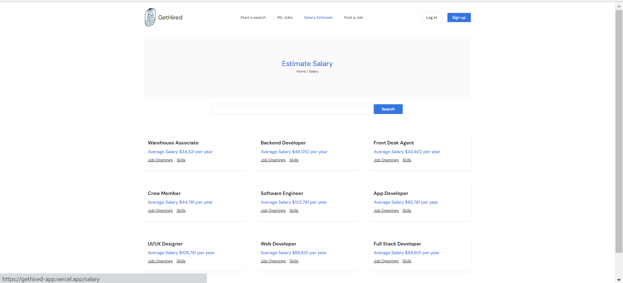
User Interface
Salary Estimate page

Slide 10
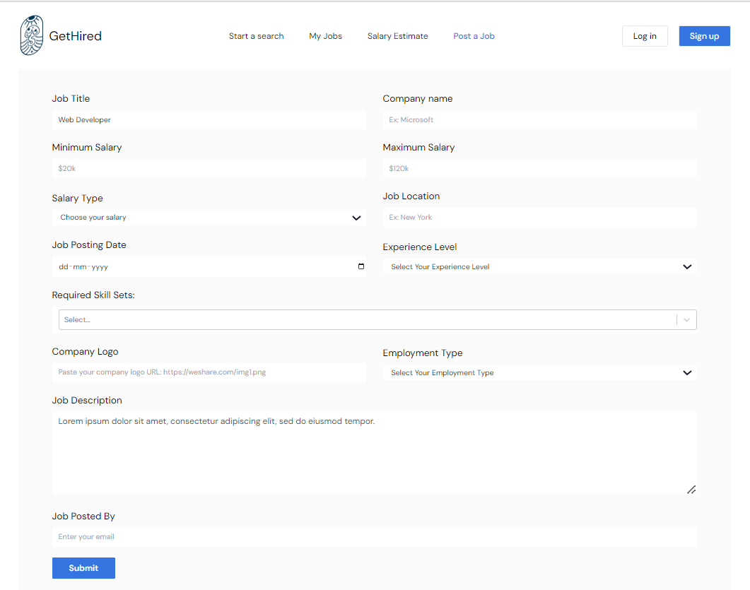
User Interface
Post a job page

Slide 11
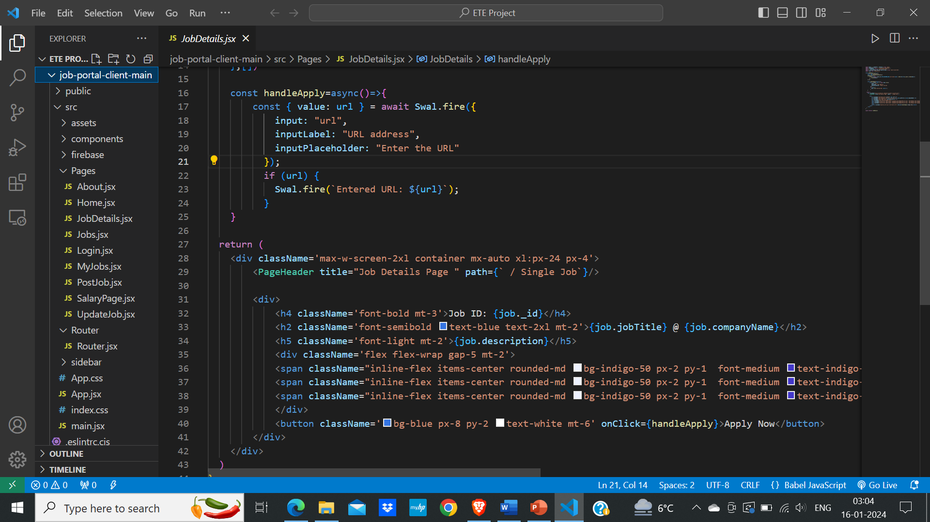
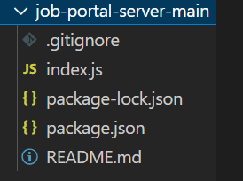
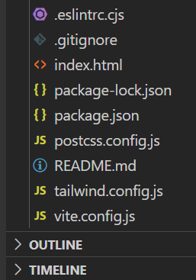
Folder Structure and Code Overview
Client side
Server side

Slide 12

Overviews
Full-stack development, sorting, authentication.
Page design and salary page.
'Post a Job,' 'Routes Handler,' and 'Newsletter.’
'Job' section, update functions, and 'MyJob.'

Slide 13
Explanation About Project
Backend Development:
development of the backend, incorporating robust functionalities for efficient data processing.
Frontend Development:
Spearheaded the creation of the frontend, ensuring a responsive and engaging user interface.
Home Section:
Implemented the home section, providing users with an informative and dynamic landing page.
Sorting and Authentication:
Integrated sorting functionalities for enhanced user experience.
Implemented secure authentication features to safeguard user data.

Slide 14
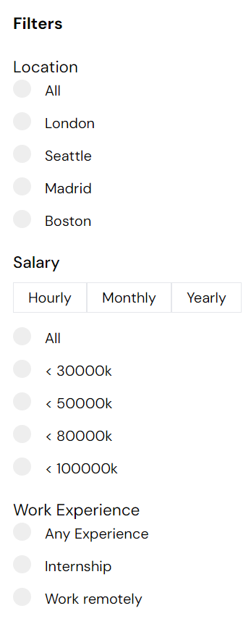
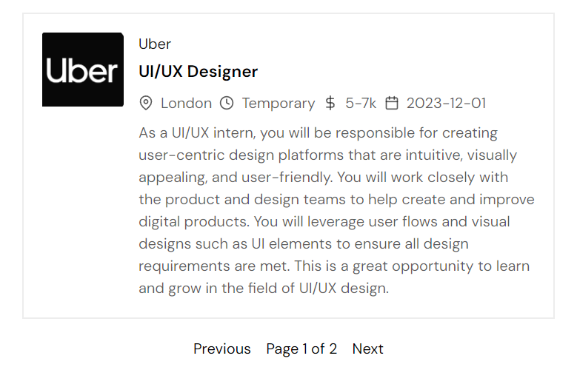
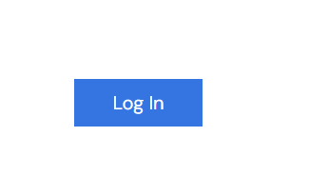
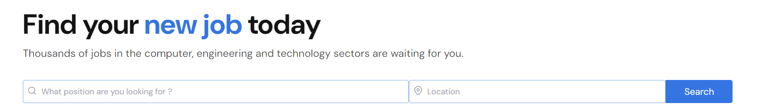


Slides

Slide 15
Slides

Slide 16
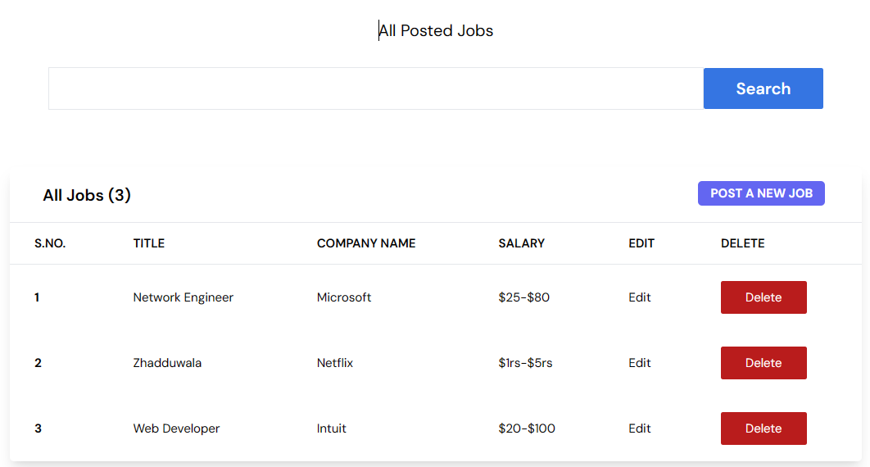
Slides

Slide 17
Slides

Slide 18

Key Features and Functionality:
1. Comprehensive Job Search
2. Efficient Recruitment Process
3. Dynamic Home Section
4. Job Management and Updates
5. Salary Information
6. Responsive Design
7. Security Measures
8. Continuous Improvement and Feedback Loop
9. Job Update Functionality
10. Routes Handling

Slide 19

Tech-stack used
Frontend: HTML, Tailwind CSS, JavaScript, ReactJS
Backend: NodeJS, ExpressJS
DB: MongoAtlas DB Cluster
Authentication: Firebase
Version Control: Git, GitHub
Frontend deployed on Vercel
Backend deployed on Render

Slide 20

Future Enhancements
1. AI-Powered Job Matching
2. Personalized User Dashboards
3. Integration of Skill Assessments
4. Expanded Industry Insights
5. Mobile Application Development
6. Social Media Integration
7. Gamification for User Engagement
8. Advanced Analytics Dashboard
9. Enhanced Security Measures
10. Improved UI and Theme Button

Slide 21
Thank You! ☺
Akshit Goel
2110990136(16-A)

